Slide 1
How does One Start Coding from Scratch? Goals:
How to Use Traditional Literature to Establish Basic Characters & States;
How to help students work out characters & states for under-studied clades;
Expanding existing cladistic matrices using traditional comparative descriptions (see Dececchi et al 2016: PLOS ONE 11:e0155680).

Slide 2
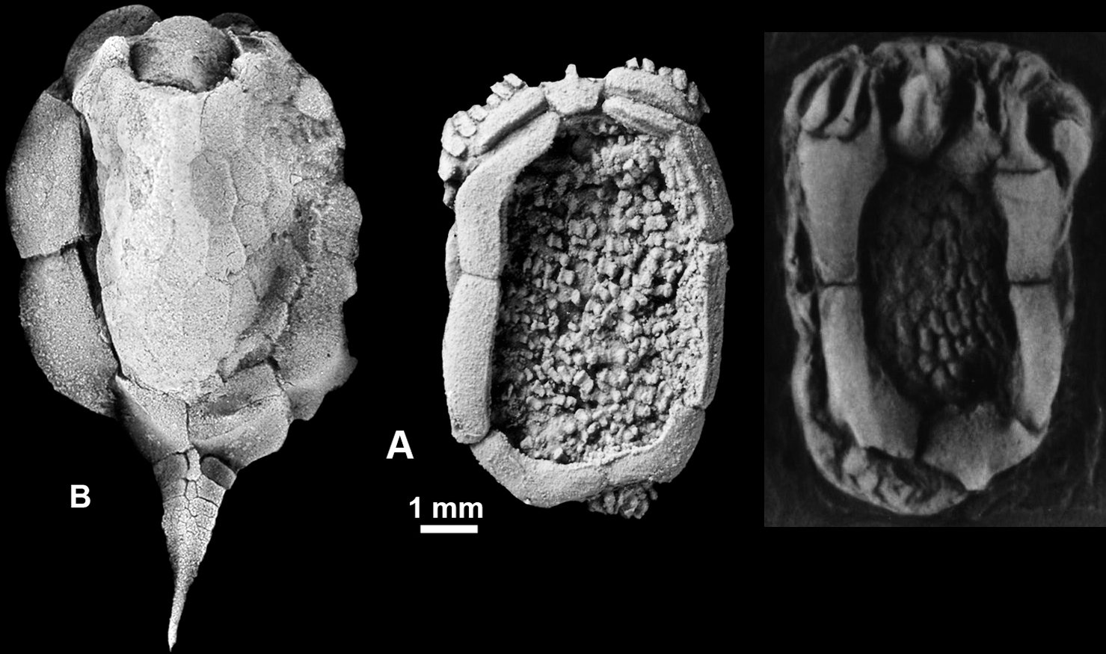
Example with Ctenocystoid Echinoderms
Cinctan
Ctenocystoids
Gyrocystis
erecta
Ctenocystis utahensis
Ctenocystis colodon
Smith & Zamora use Ctenocystis utahensis as the outgroup in their cinctan analysis.

Slide 3
Example with Ctenocystoid Echinoderms
Scenario: suppose a young grad student thinks that phylogenies of Cambrian echinoderms would help his/her project.
Wants to add ctenocystoid analyses to cinctan, mitrate, etc., analyses.
No prior phylogenetic work on this group: so, how to learn Ctenocystoids?

Slide 4
Anatomies of “New” Taxa can be Overwhelming!
From David et al. 2000
With all of these different structures, where does one begin?

Slide 5
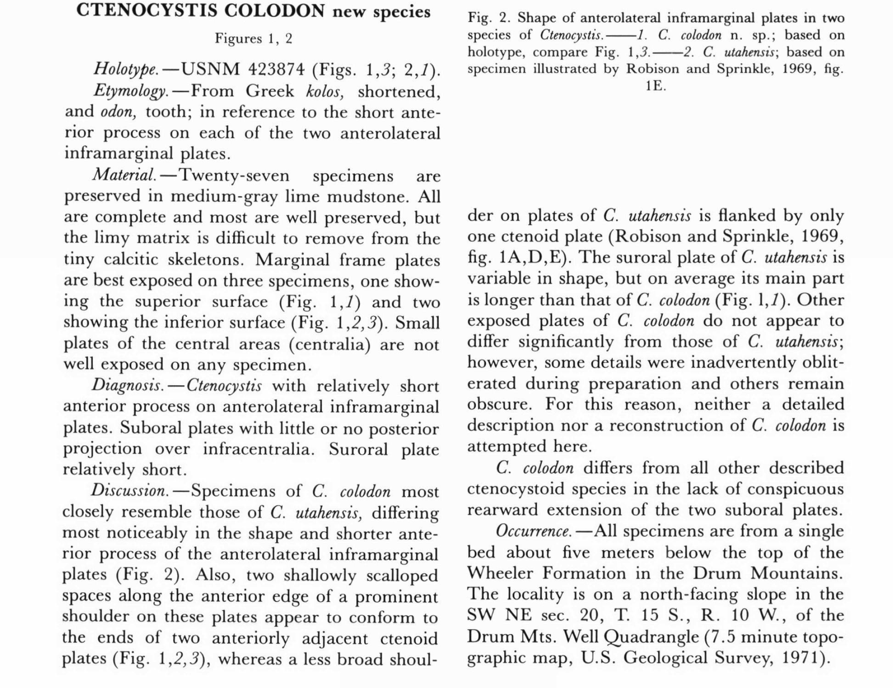
Traditional Descriptions as a Starting Point
From Ubaghs & Robison 1988

Slide 6


Diagnoses Suggest Some Basic Characters
From Ubaghs & Robison 1988
Anterior process length, suboral plate projection & suroral plate dimensions clearly important.

Slide 7
Taxon Contrasts Imply Characters & States
From Ubaghs & Robison 1988
Workers think these features changed after divergence from common ancestor in one or both species.

Slide 8
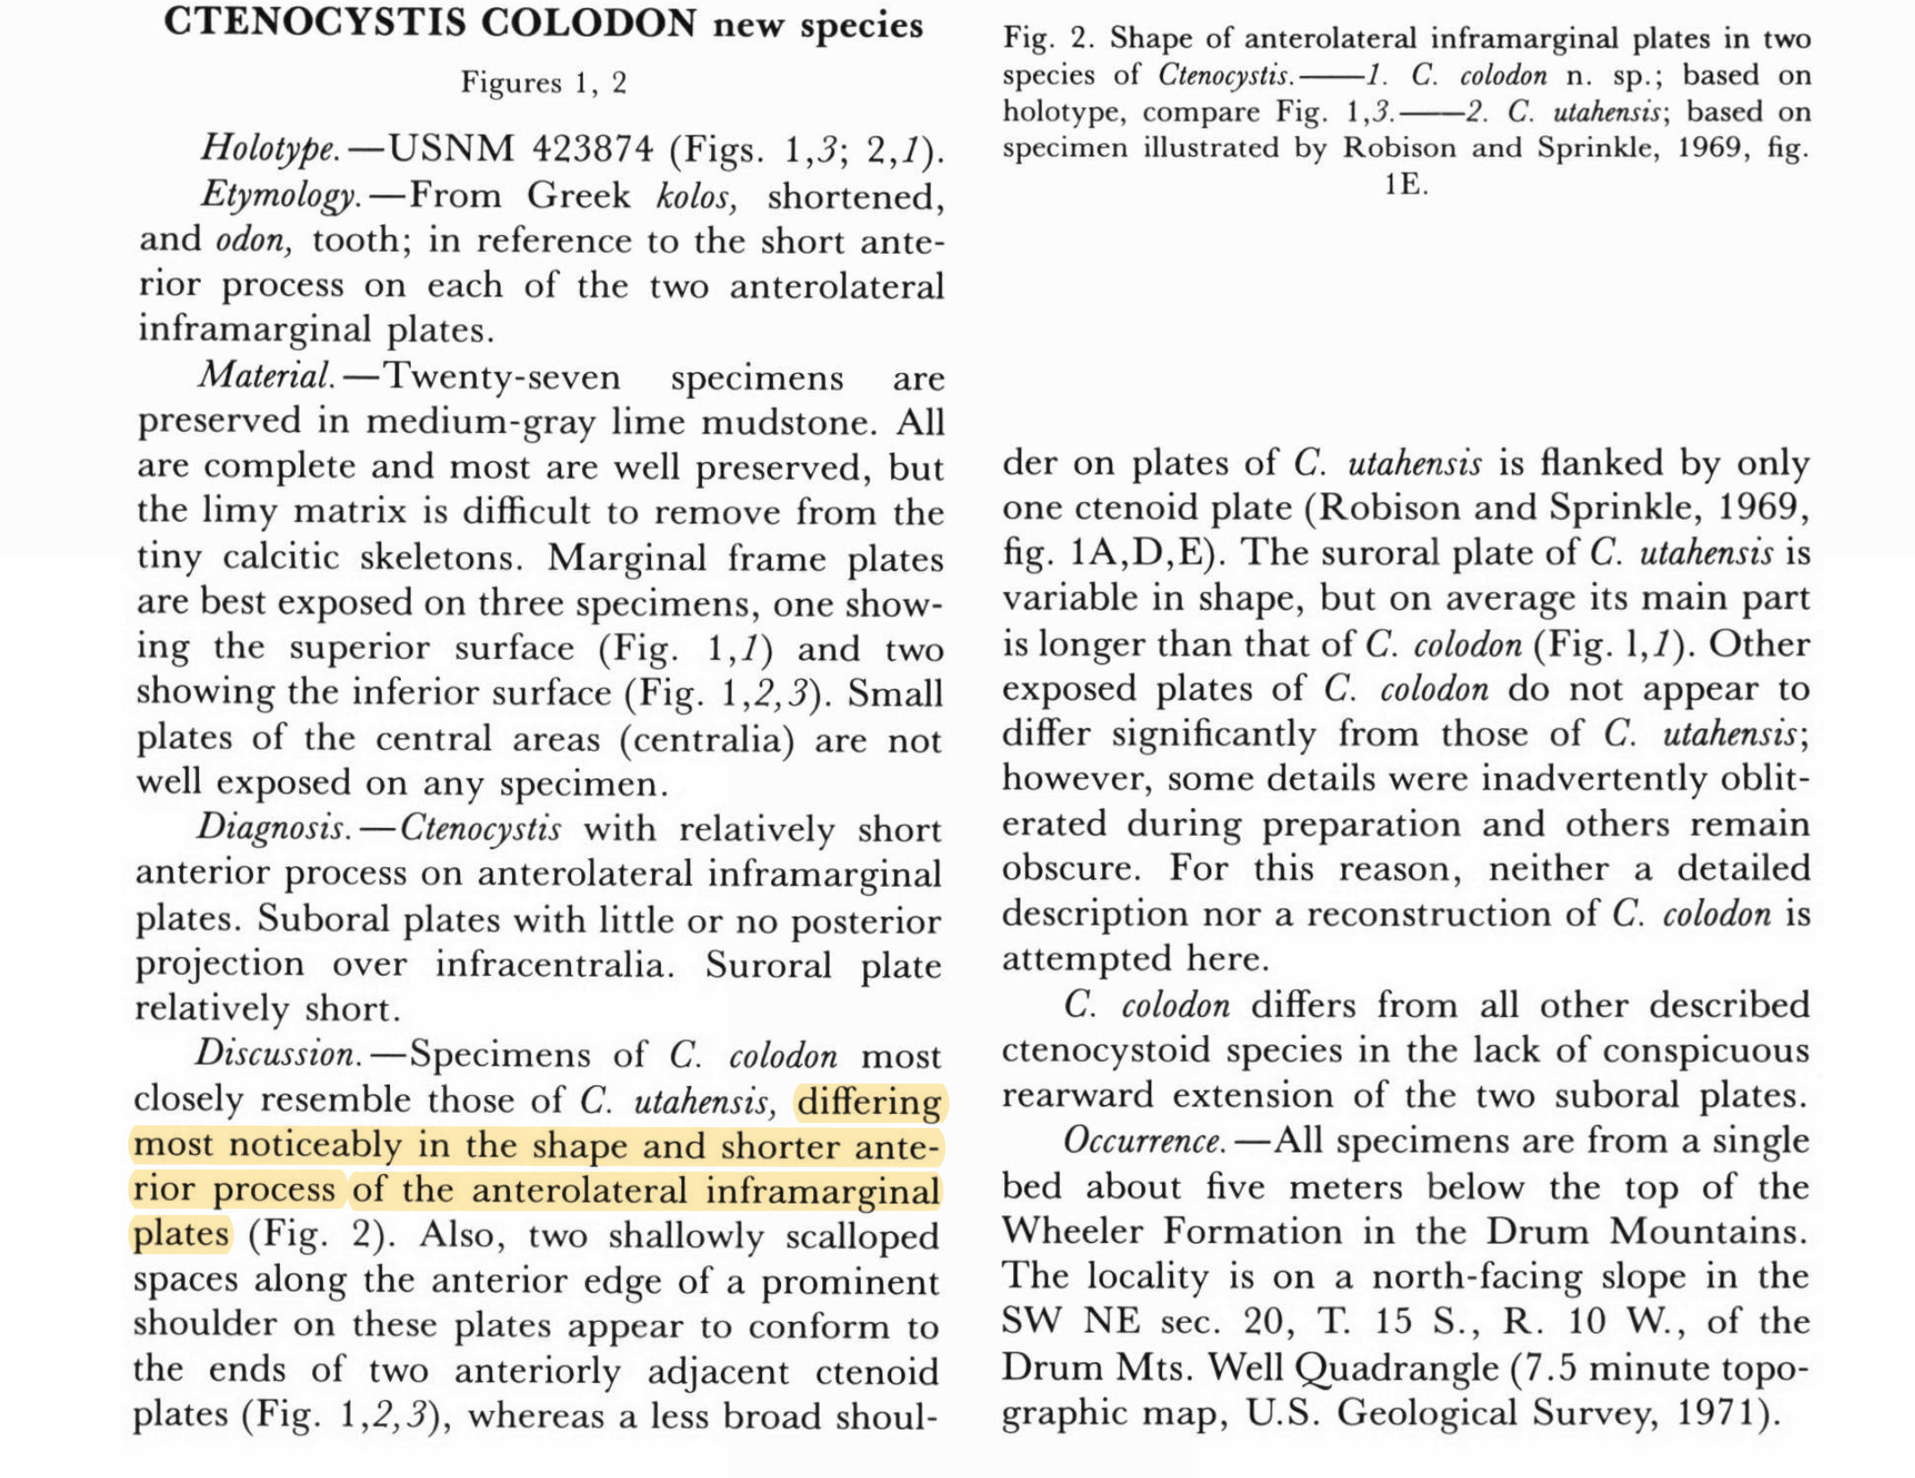
Contrasts Suggest States
From Ubaghs & Robison 1988
Shape & length of anterior process of anterolateral inframarginal plate has changed.

Slide 9
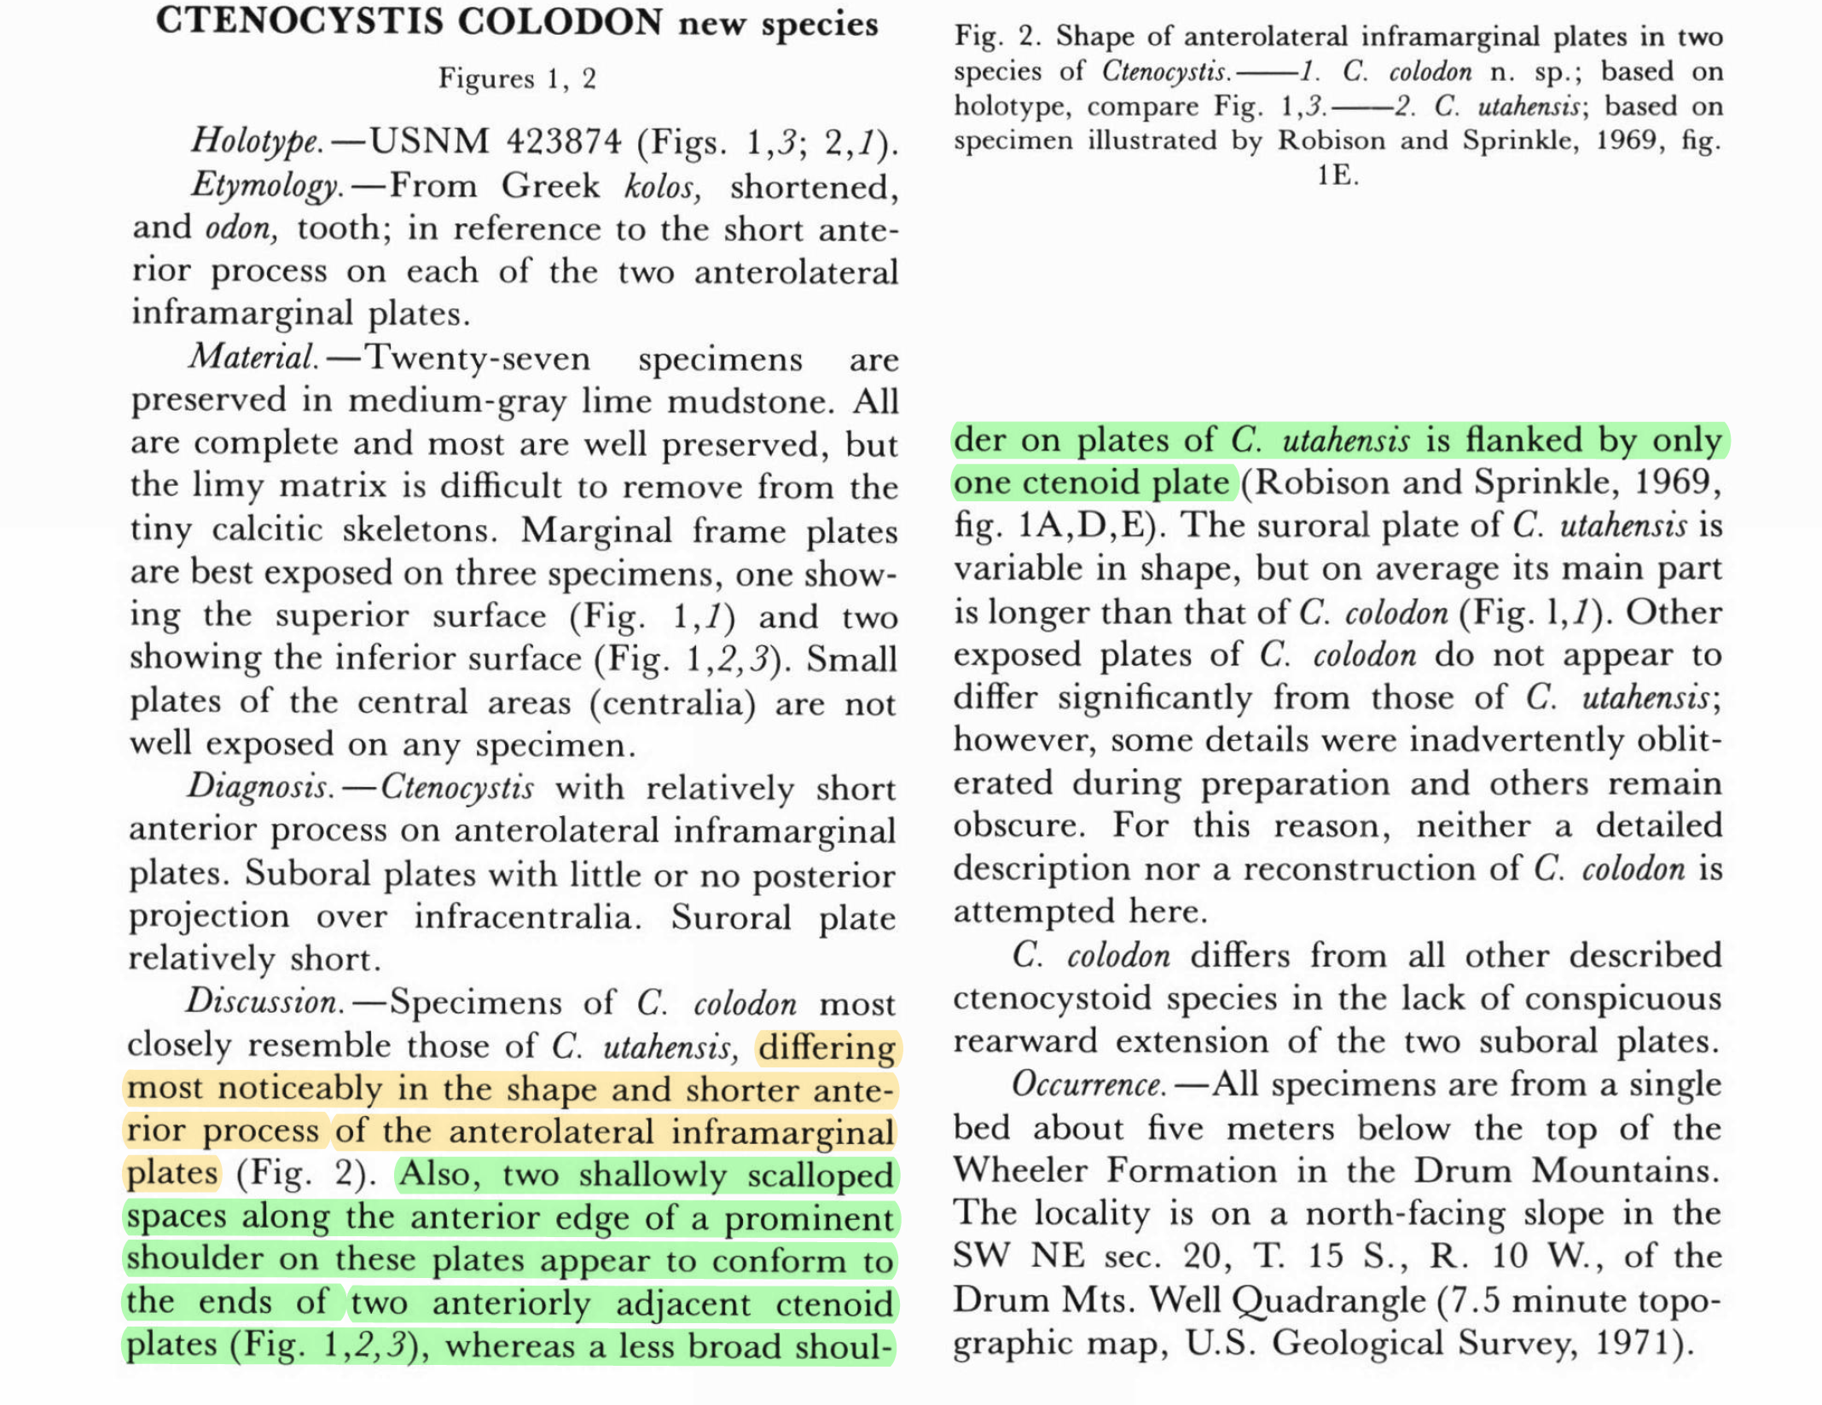
Contrasts Suggest States
From Ubaghs & Robison 1988
Number & position of plates adjacent to anterior process has changed.

Slide 10
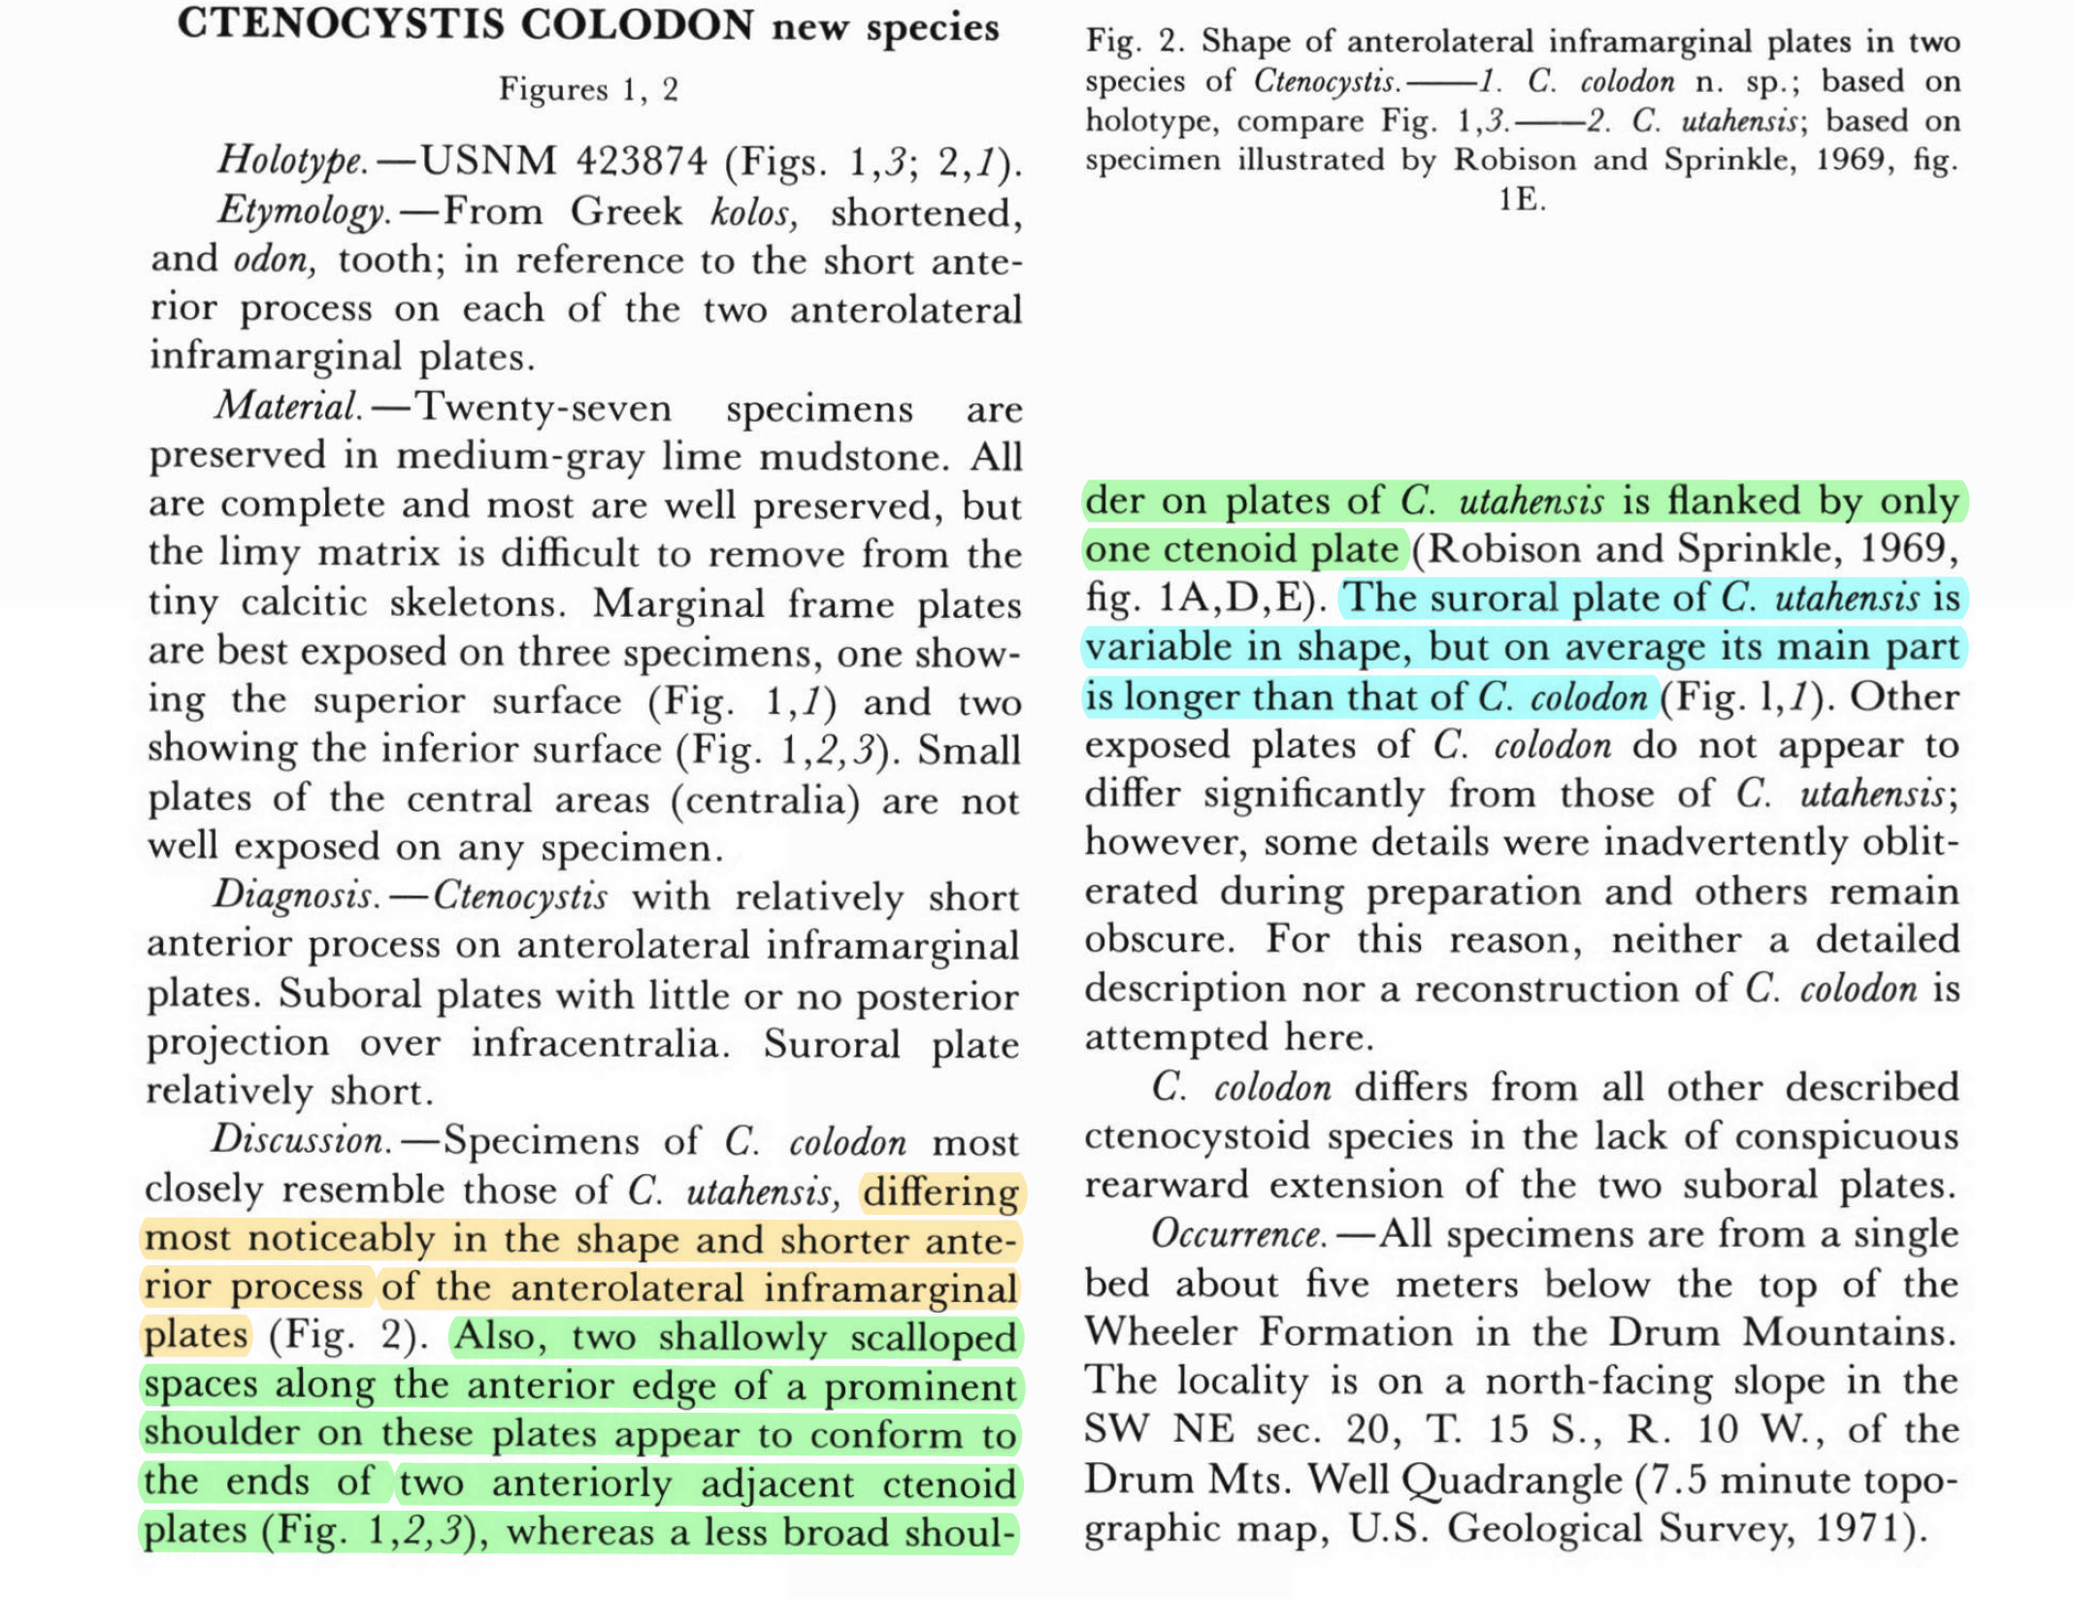
Contrasts Suggest States
From Ubaghs & Robison 1988
Suroral plate length has changed.

Slide 11
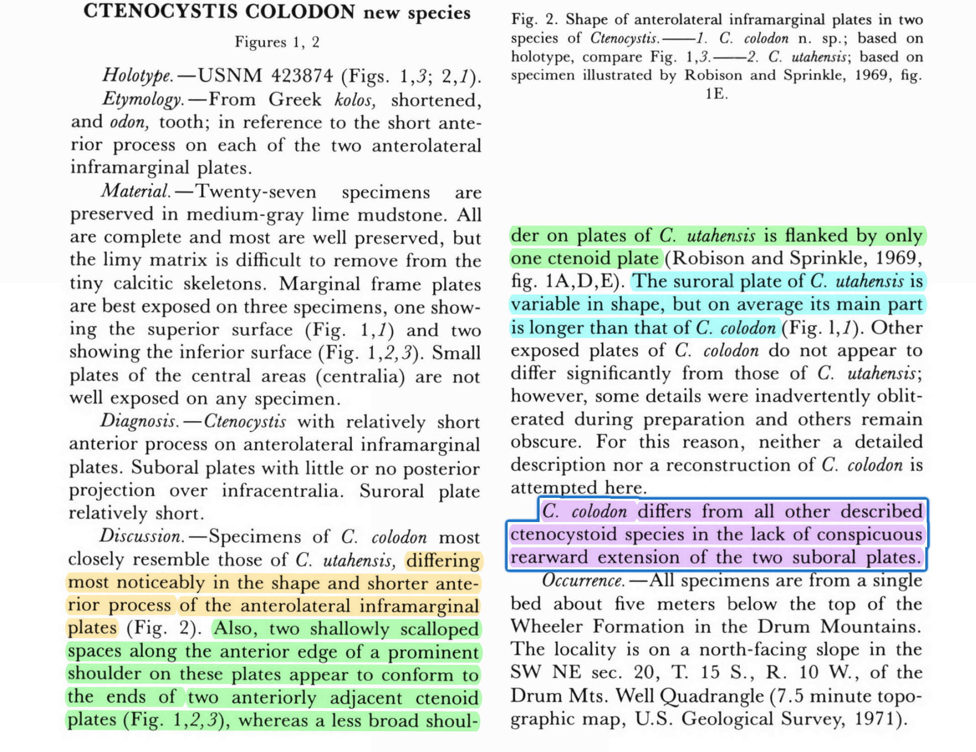
Taxon Contrasts Suggest Different States
From Ubaghs & Robison 1988
Whether suboral plates extend rearward has changed.

Slide 12
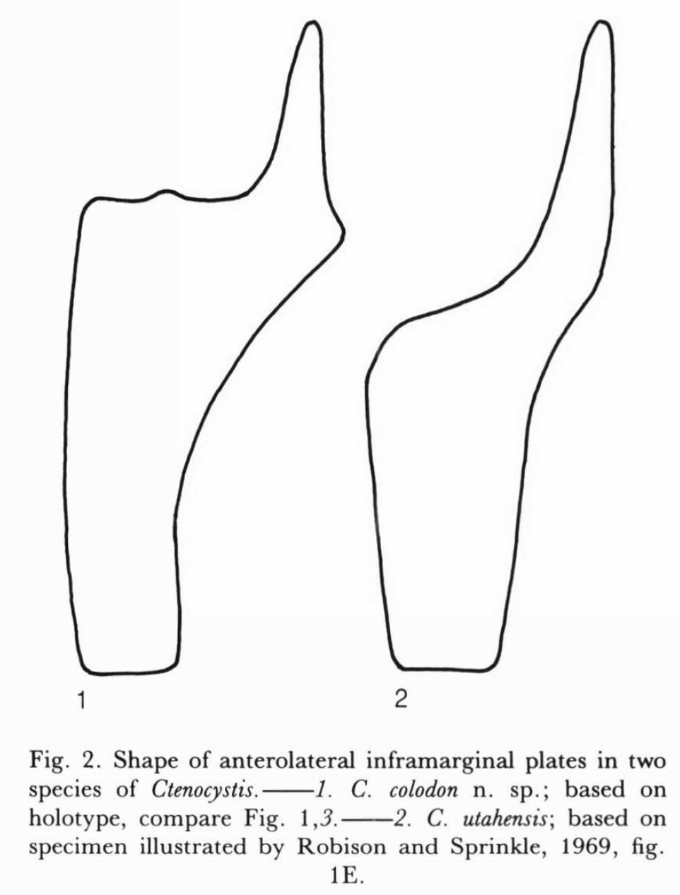
Species Discussions often Focus on Differences rather than Conditions (States)
C. colodon
C. utahensis
From Ubaghs & Robison 1988
Multiple differences listed for Anterolateral Inframarginal Plates

Slide 13
Species Discussions often Focus on Differences rather than Conditions (States)
C. colodon
C. utahensis
Anterior Process
From Ubaghs & Robison 1988
Shape & Lengths of Anterior Processes.
Note: Be careful with relative conditions!

Slide 14
Species Discussions often Focus on Differences rather than Conditions (States)
C. colodon
C. utahensis
Scalloped Spaces
From Ubaghs & Robison 1988
Presence/absence of scalloped spaces on anterior shoulder: really two “ridges”?

Slide 15
Descriptions & Discussions Can Miss Features that Might be Important
C. colodon
C. utahensis
From Ubaghs & Robison 1988
No mention of presence/absence of ridge below anterior process.

Slide 16


Descriptions & Discussions Can Miss Features that Might be Important
C. colodon
C. utahensis
From Ubaghs & Robison 1988
No mention of differences in inner side outlines.
Continuous curve vs. nearly straight

Slide 17
Descriptions & Discussions Can Miss Features that Might be Important
C. colodon
C. utahensis
From Ubaghs & Robison 1988
No mention of projection of outer side.
Nearly straight “up” vs. forward

Slide 18
Switch to Mesquite

Slide 19
Short Exercise: Repeat this with the Suroral Plates
C. colodon
C. utahensis
Modified from Ubaghs & Robison 1988
Modified from Rahman & Clausen 2009
From Diagnosis of C. colodon
From Discussion of C. colodon
Discuss it for ~ 5 minutes & put tables’ answers:
https://etherpad.wikimedia.org/p/ctenocystoids

Slide 20

*hum Jeopardy Music…*

Slide 21
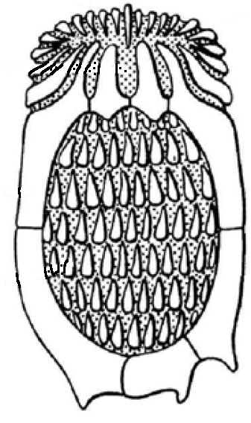
Caveat Emptor: This is A Start Only!!! Your Coding will “Evolve” from Here!
Character Independence not important for traditional descriptions.
Coding should capture features once only.
Example: Code “front” of small plate as convex or “back” of large plate as concave.

Slide 22
Caveat Emptor: This is A Start Only!!! Looking at Many Specimens is Important*
Intraspecific variation ignored in some traditional descriptions.
States polymorphic in one species might be diagnostic of another species.
Enter 0&1 if polymorphic.
*: Offer valid only when the fossil record cooperates.

Slide 23
Caveat Emptor: This is A Start Only!!! Looking at Many Specimens is Important*
Intraspecific variation ignored in some traditional descriptions.
States polymorphic in one species might be diagnostic of another species.
Enter 0&1 if polymorphic.
Traditional descriptions ignore taphonomy.
When possible, use wide-ranging species to see how different preservation affects states.
*: Offer valid only when the fossil record cooperates.

Slide 24
Code All Features & Cast Broad Taxonomic Nets
Today’s novel features might be shared with species in the next issue of J.P.
Increase the chance of recognizing that a group is paraphyletic.
Often coincides with major changes.
Both might offer antidotes to ascertainment bias: the difficulty of recognizing characters that could have changed but did not.

Slide 25
☕️

Slide 26
(Convert Mesquite ☛ RevBayes in R)
FINAL PART
to set up April’s Section
Video 3 Here

Slide 27
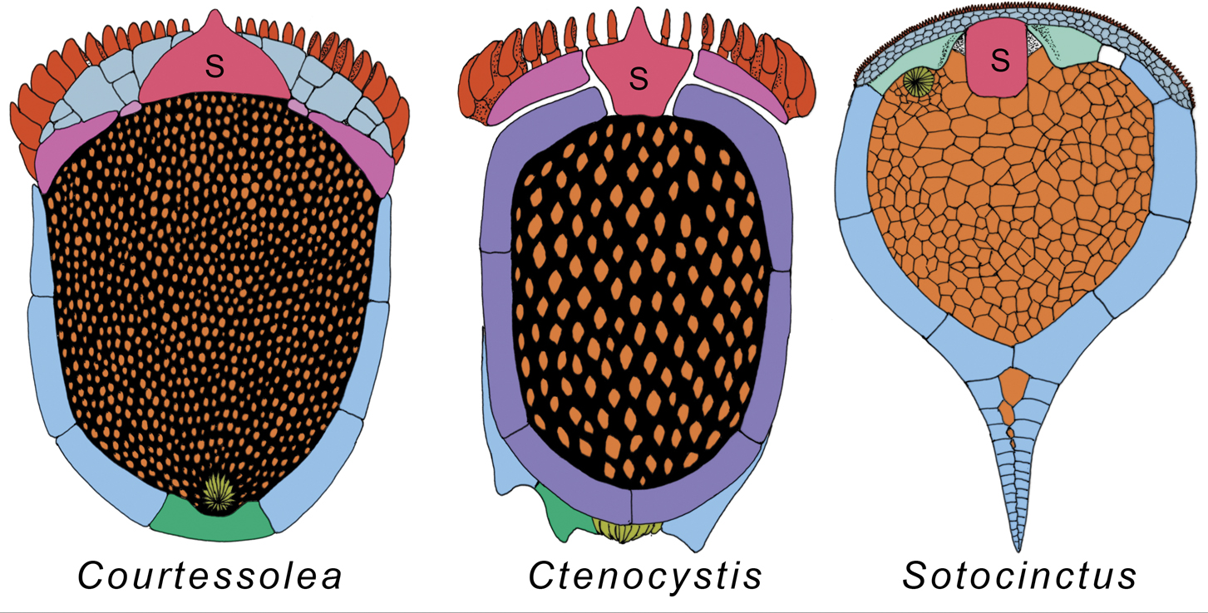
Cast a Broad Net with Taxonomic Coverage
Ctenocystoid
Ctenocystoid
Cinctan
Modified from Zamora et al. 2012
Left-Right symmetry of plate positions varies.

Slide 28






Slide 29
Moving Beyond Descriptions to Specimens: Species are not Invariant!
Traditional descriptions often ignore ontogeny.
Spc. 1 Ontogeny: States A➝B
Spc. 2 Ontogeny: States A➝B➝C
Coding should show that 1 & 2 possess A & B.
Coding should also show that 1 & 2 have different ontogenies.
Ontogenies themselves can provide characters.

Slide 30
Moving Beyond Descriptions to Specimens: Species are not Invariant!
We need to account for preservation:
The same states might look different on silicified and calcitic specimens.
The same states might look different on specimens from limestones vs. those from shales.
When possible, use wide-ranging species as controls for “state taphonomy.”

Slide 31
Be Cognizant of Different Possible Evolutionary Models when Coding
Polymorphisms might represent:
1. Ecophenotypic variation;
2. Different heritable conditions that might become fixed in daughter taxa.
States appearing at different ontogenetic stages might represent:
1. Parallel derivations;
2. Shifts in ontogeny.

Slide 32
One Part of an Organism never is Independent of other Parts
One plate is concave where other is convex.
Code this only once!

Slide 33
One Part of an Organism never is Independent of other Parts
Goal: Capture all versions of Plate A without duplicating that information on Plates B…Z!
∴ Plate arrangement and contact shapes might be better characters here.
Traditional descriptions often do not worry about this!

Slide 34
Moving Beyond Descriptions to Specimens: Species are not Invariant!
Traditional descriptions often ignore intraspecific variation
“Splitters” were common!
Coding often will lump multiple named species.
Previously described differences often reflect polymorphic states.
States polymorphic in one species might be diagnostic of another species

Slide 35
(This Section Probably Will Need to be Cut)

Slide 36
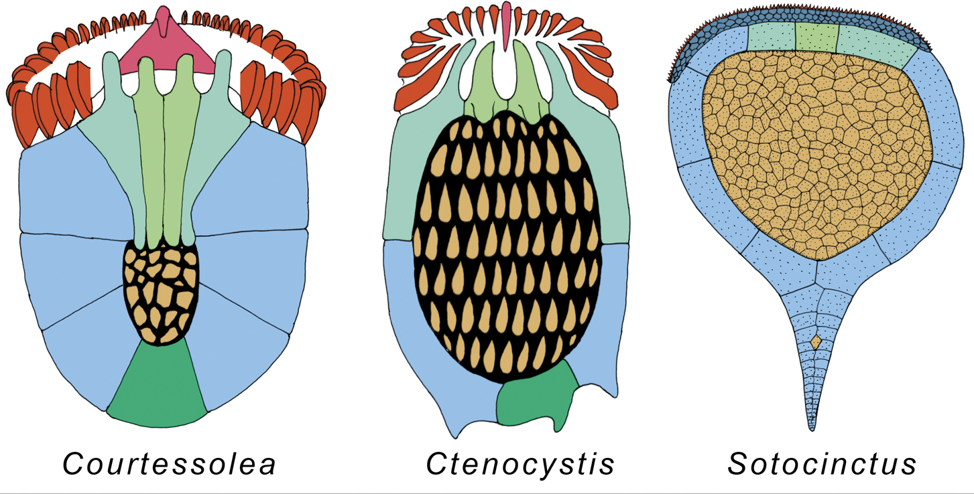
Cast a Broad Net with Taxonomic Coverage
Ctenocystoid
Ctenocystoid
Cinctan
Modified from Zamora et al. 2012
Similarities in posterior plates between some ctenocystoids & cinctans.
Paraphyly often coincides with major transitions.

Slide 37
Cast a Broad Net with Taxonomic Coverage
Ctenocystoid
Ctenocystoid
Cinctan
Modified from Zamora et al. 2012
Similarities in posterior plates between some ctenocystoids & cinctans.
There might be fusion/splitting of plates (= coupling/decoupling of homologies)

Slide 38
Cast a Broad Net with Taxonomic Coverage
Ctenocystoid
Ctenocystoid
Cinctan
Modified from Zamora et al. 2012
Posterior plates highly asymmetrical in some taxa, but not others.

Slide 39
Cast a Broad Net with Taxonomic Coverage
Ctenocystoid
Ctenocystoid
Cinctan
Modified from Zamora et al. 2012
~ Symmetrical anterior plates on taxa with very asymmetrical posterior plates.
Another type of decoupling of homologies.

Slide 40
Evolution of Homologies Presents Methodological Challenges
Serial repetition, fusion, symmetry, etc., all point to “deeper” homologies than single characters.
Developmental sequences of states present analogous problems.
Closer to EvoDevo definitions of homology.
Your task at this point?
Code all of the information.
Find/develop methods that allow for these complexities later!

Slide 41
Anatomies of “New” Taxa can be Overwhelming!
From David et al. 2000
With all of these different structures, where does one begin?

Slide 42
Caveat Emptor: This is A Start Only!!! Looking at Many Specimens is Important*
Intraspecific variation ignored in some traditional descriptions.
States polymorphic in one species might be diagnostic of another species.
Ontogenetic trajectories can provide important information.
Both for different states & transitions.

Slide 43
Caveat Emptor: This is A Start Only!!! Your Coding will “Evolve” from Here!
Character Independence not important for traditional descriptions.
Coding should capture features once only.
Intraspecific variation ignored in some traditional descriptions.
States polymorphic in one species might be diagnostic of another species.
Traditional descriptions ignore taphonomy.
When possible, use wide-ranging species to see how different preservation affects states.

